Slide 1
Should the South be punished?
Reconstruction

Slide 2
Reconstruction
(1865-1876)

Slide 3
Key Questions
1. How do we bring the South back into the Union?
4. What branch of government should control the process of Reconstruction?
3. How do we integrate and protect newly- emancipated black freedmen?
2. How do we rebuild the South after its destruction during the war?

Slide 4
Wartime
Reconstruction

Slide 5
President Lincoln’s Plan
10% Plan
Formally called the “Proclamation of Amnesty and Reconstruction” (December 8, 1863)
Lincoln didn’t consult Congress regarding Reconstruction.

Slide 6
Opposed By…
Radical Republicans – wanted laws that supported African Americans rights
Radical Republicans wanted to: destroy former slave owners, give citizenship and right to vote to former slaves.

Slide 7
President Lincoln’s Plan
Details…
The US Government will PARDON all confederates except the high ranking officials.
All of those who receive a pardon will:
Swear allegiance to the Union
AND
Would promise to obey the laws

Slide 8
President Lincoln’s Plan
Lincoln’s plan was seen as being very LENIENT
Lincoln said the states had never rebelled, that individuals had rebelled and he (the President) could pardon individuals
When 10% of the voting population in the 1860 election had sworn allegiance then a new government could be formed and members elected to Congress.

Slide 9
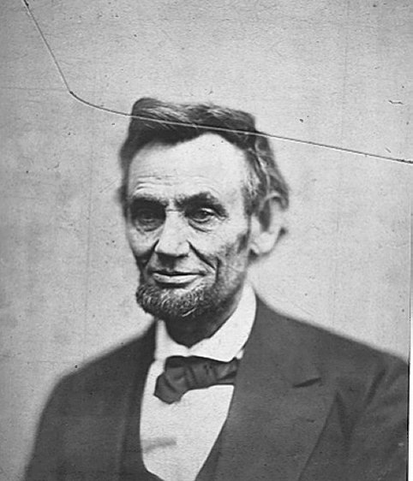
President Lincoln’s Plan
LA, TN, AR, VA approved the plan
After Lincoln was assassinated President Johnson took up the plan
But before Lincoln died…

Slide 10
Wade – Davis Bill
Radical Republican Plan

Slide 11
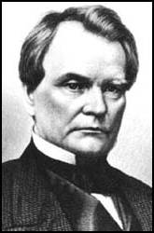
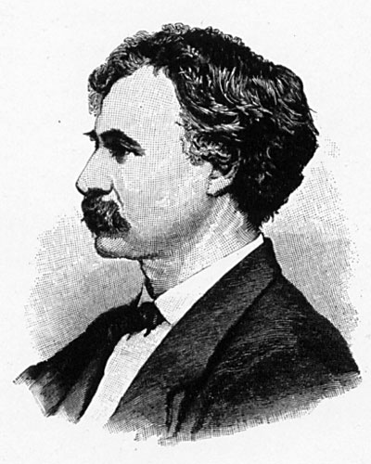
Wade-Davis Bill (1864)
Suggested by Radical Republicans in Congress
Congress would be responsible for reconstruction NOT the President
* Majority of states’ voters would need to swear oath to support the Constitution
Senator Benjamin Wade (R-OH)
Congressman Henry W. Davis (R-MD)

Slide 12
Wade-Davis Bill (1864)
The Wade-Davis Bill was opposed by Lincoln
Lincoln killed the bill with a pocket veto
Congress was very angry
Then Lincoln was assassinated

Slide 13
Presidential
Reconstruction
Proposed by President Johnson

Slide 14
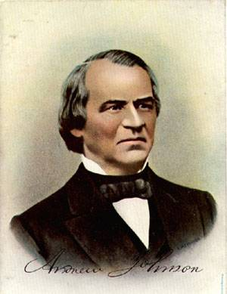
President Andrew Johnson
Anti-Aristocrat.
White Supremacist.
Agreed with Lincoln that states had never legally left the Union.
Damn the negroes! I am fighting these traitorous aristocrats, their masters!

Slide 15
Presidential Reconstruction
Johnson’s Plan was OPPOSED by…
Radical Republicans – the plan did not address needs of African American’s in land, voting rights, and protection of the laws,
Johnson pardoned all new southern congressmen
Later Moderate Republicans also opposed

Slide 16
President Johnson’s Plan (10%+)
Alabama, Florida, Georgia, Mississippi, NC, SC, and Texas could be readmitted IF…
Each state would swear their secession was illegal AND
Swear allegiance to Union AND
Ratify 13th amendment
Johnson tried to exclude former slave owners from taking the oath and getting voting privileges back

Slide 17
Presidential Reconstruction
Johnson’s Plan was Supported by…
* White southerners - Why?
* Johnson supported states’ rights (which meant states could exclude African Americans from voting), pardoned many southerners so that “white men “ could “manage the South”

Slide 18
13th Amendment
Ratified in December, 1865.
Neither slavery nor involuntary servitude, except as punishment for crime whereof the party shall have been duly convicted, shall exist within the United States or any place subject to their jurisdiction.
Congress shall have power to enforce this article by appropriate legislation.

Slide 19
What happened to the plan?
Radical Republicans refused to admit new Southern Congressmen
Johnson vetoed Freedmen’s Bureau Act and Civil Rights Act of 1866 that forbade black codes

Slide 20
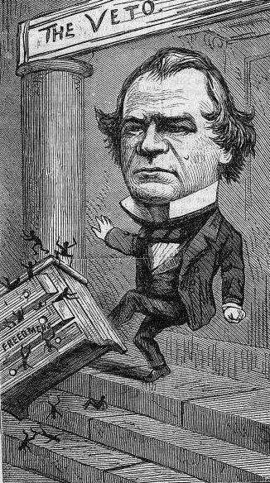
Congress Breaks with the President
Congress bars Southern Congressional delegates.
Joint Committee on Reconstruction created.
February, 1866 → President vetoed the Freedmen’s Bureau bill.
March, 1866 → Johnson vetoed the 1866 Civil Rights Act.
Congress passed both bills over Johnson’s vetoes → 1st in U. S. history!!

Slide 21
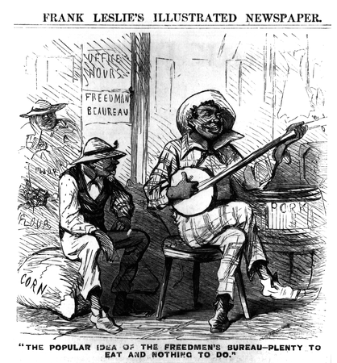
Freedmen’s Bureau Seen Through Southern Eyes
Freedmen's Bureau

Slide 22
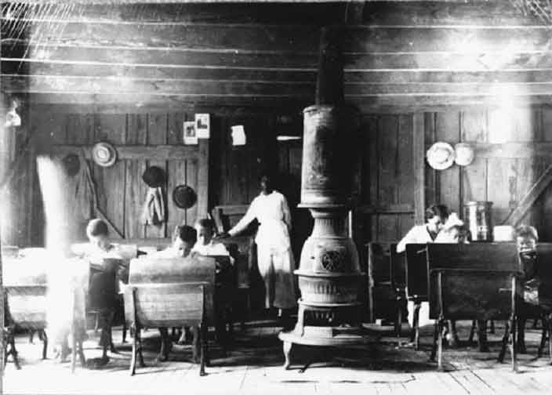
Freedmen’s Bureau School

Slide 23
Black Codes/ Reconstruction Videos
https://www.youtube.com/watch?v=pDW3fp4vF3o
https://www.youtube.com/watch?v=GsARLsWnqpY
http://www.pbs.org/video/slavery-another-name-origins-black-codes/

Slide 24
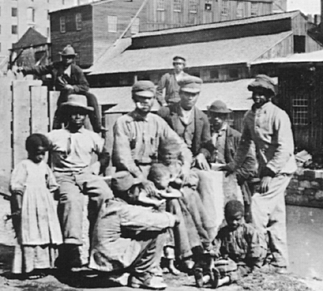
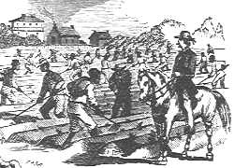
Black Codes
Purpose:
Restore pre-emancipation system of race relations
Prohibited blacks from…carrying guns, serving on juries, testifying against whites, traveling without permits, starting businesses
Forced many blacks to become sharecroppers [tenant farmers].

Slide 25
Radical
(Congressional)
Reconstruction
Suggested by Radical and Moderate Republicans

Slide 26
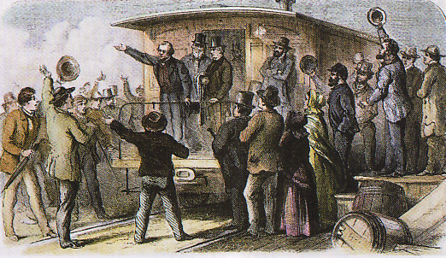
The 1866 Mid-term Election
Johnson made an ill-conceived propaganda tour around the country to push his plan.
Johnson offended
many people
Republicans won a 3-1 majority in both houses and gained control of every northern state.
Johnson’s “Swing around the Circle”

Slide 27
Congressional Reconstruction Act of 1867
* Did NOT recognize state government’s formed under Lincoln or Johnson’s Plans,
EXCPET TENNESSEE which ratified the 14th Amendment

Slide 28
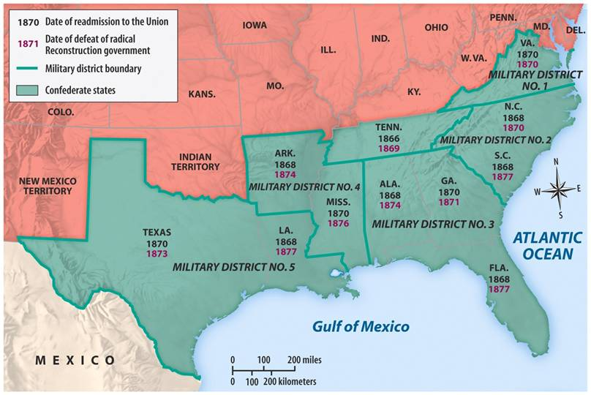
* Divided Confederate states into 5 military districts headed by a Union General
AND

Slide 29
* States would have conventions to write constitutions that would include – right to vote for African American men
AND
States must ratify 14th Amendment

Slide 30
Johnson VETOED the plan and Congress IMMEDIATELY OVERRODE the veto…
…which made Congressional Reconstruction the OFFICIAL RECONSTRUCTION PLAN

Slide 31
Congress does not like Johnson and wants to get him out of office
In March 1867 Congress passes the
Tenure of Office Act
The President could not remove any officials [esp. Cabinet members] without the Senate’s consent, if the position originally required Senate approval.

Slide 32
President Johnson’s Impeachment
Johnson fires Secretary of War Edwin Stanton in February, 1868
The House impeached Johnson on February 24 by a vote of 126 – 47!

Slide 33
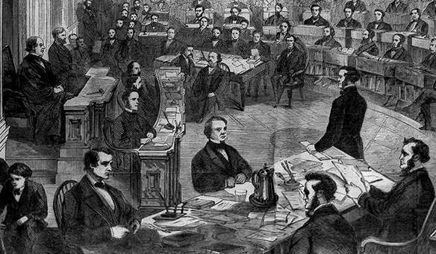
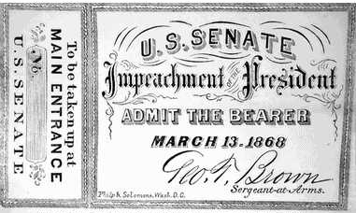
The Senate Trial
11 week trial.
Johnson acquitted 35 to 19 (one short of required 2/3s vote to remove from office).

Slide 34
The
Grant
Administration
(1868-1876)

Slide 35
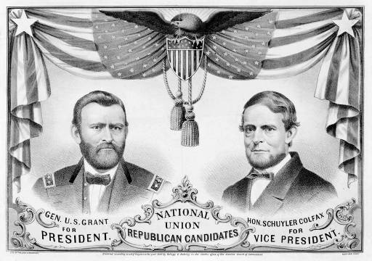
The 1868 Republican Ticket
Ulysses S. Grant
Schuyler Colfax

Slide 36
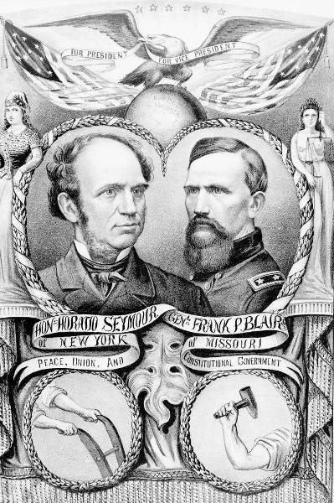
The 1868 Democratic Ticket
Horatio Seymour
Frank Blair

Slide 37
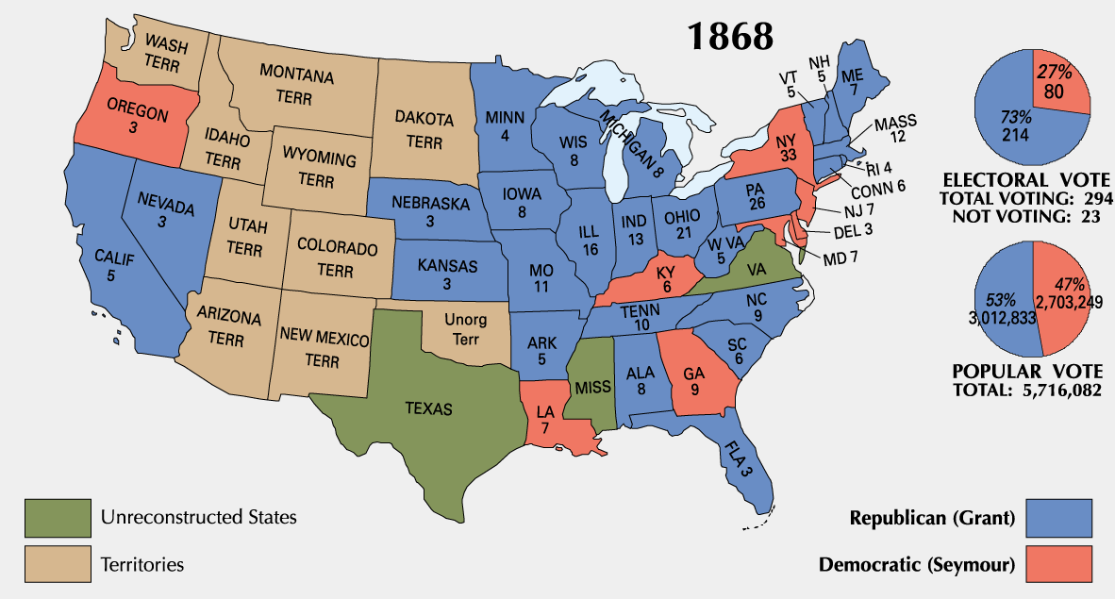
1868 Presidential Election

Slide 38
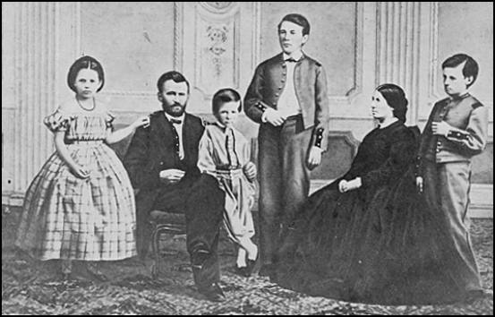
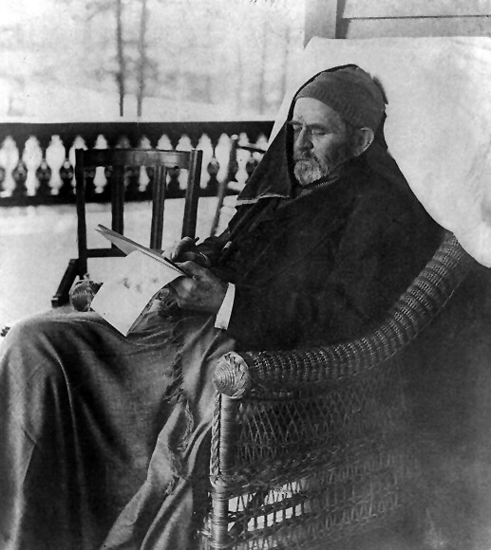
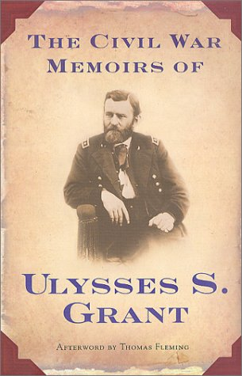
President Ulysses S. Grant

Slide 39
Black
"Adjustment"
in the South

Slide 40
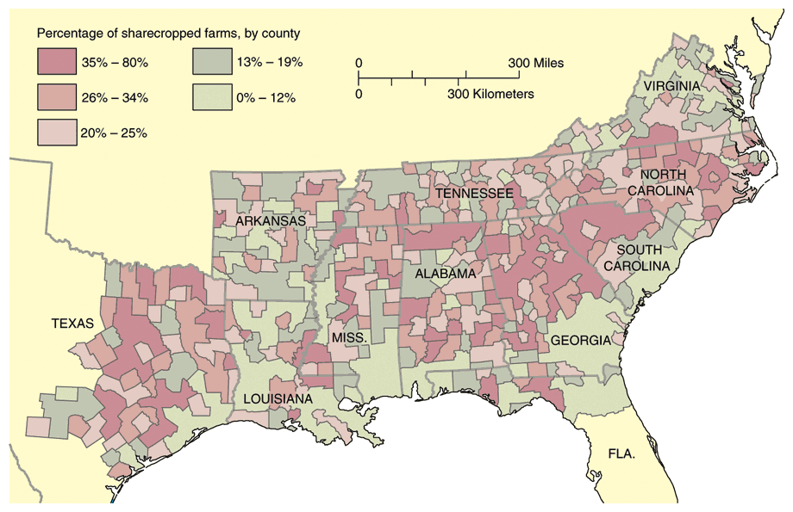
Sharecropping

Slide 41
Tenancy & the Crop Lien System
Furnishing Merchant | Tenant Farmer | Landowner
Loan tools and seed up to 60% interest to tenant farmer to plant spring crop. Farmer also secures food, clothing, and other necessities on credit from merchant until the harvest. Merchant holds “lien” {mortgage} on part of tenant’s future crops as repayment of debt. | Plants crop, harvests in autumn. Turns over up to ½ of crop to land owner as payment of rent. Tenant gives remainder of crop to merchant in payment of debt. | Rents land to tenant in exchange for ¼ to ½ of tenant farmer’s future crop.

Slide 42
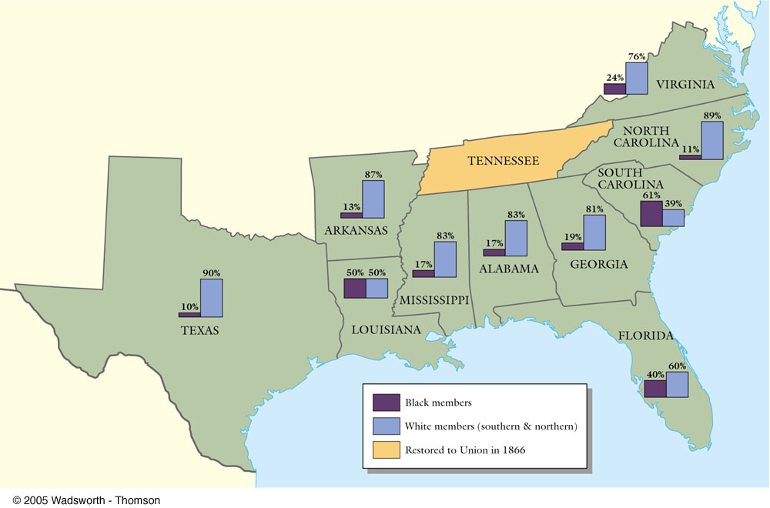
Black & White Political Participation

Slide 43
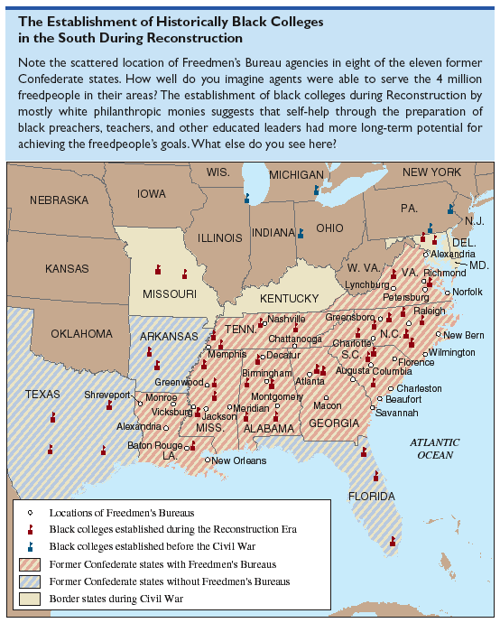
Establishment of Historically Black Colleges in the South

Slide 44
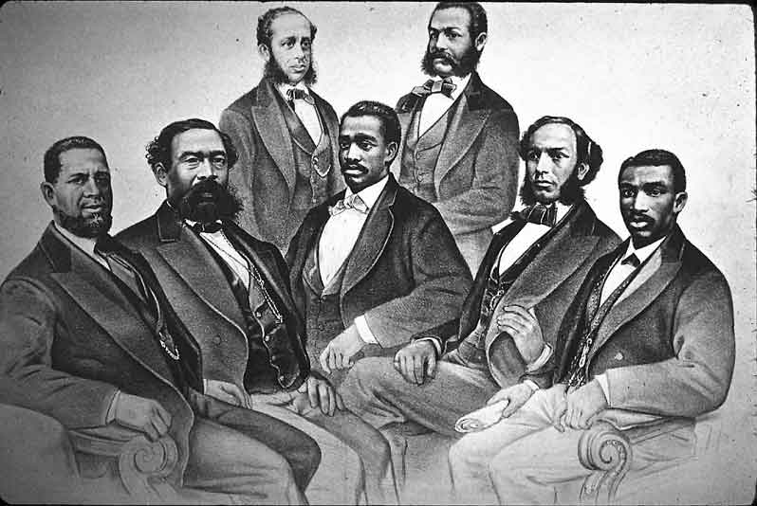
Black Senate & House Delegates

Slide 45
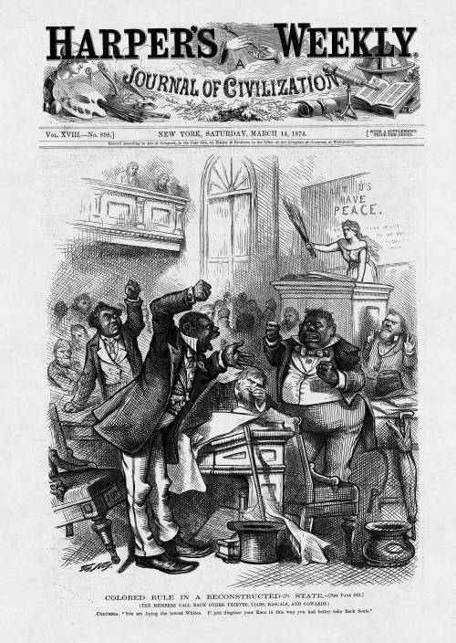
Colored Rule in the South?

Slide 46
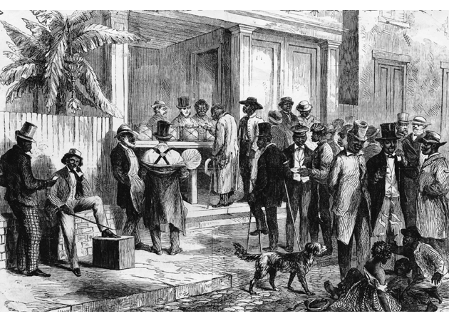
Blacks in Southern Politics
Core voters were black veterans.
Blacks were politically unprepared.
Blacks could register and vote in states since 1867.
The 15th Amendment guaranteed federal voting.

Slide 47
15th Amendment
Ratified in 1870.
The right of citizens of the United States to vote shall not be denied or abridged by the United States or by any state on account of race, color, or previous condition of servitude.
The Congress shall have power to enforce this article by appropriate legislation.
Women’s rights groups were furious that they were not granted the vote!

Slide 48
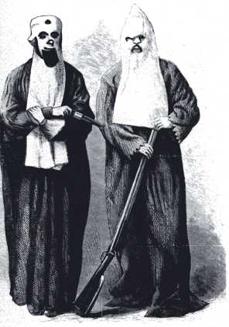
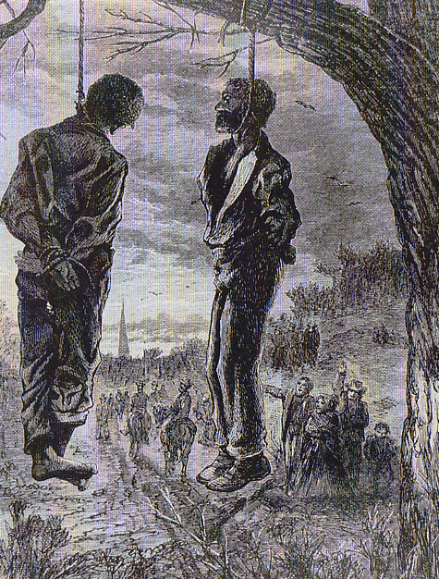
The “Invisible Empire of the South”

Slide 49
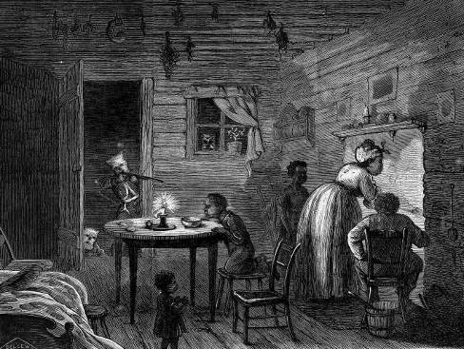
The Failure of Federal Enforcement
Enforcement Acts of 1870 & 1871 [also known as the KKK Act].
“The Lost Cause.”
The rise of the “Bourbons.”
Redeemers (prewar Democrats and Union Whigs).

Slide 50
The Civil Rights Act of 1875
Crime for any individual to deny full & equal use of public conveyances and public places.
Prohibited discrimination in jury selection.
Shortcoming → lacked a strong enforcement mechanism.
No new civil rights act was attempted for 90 years!

Slide 51
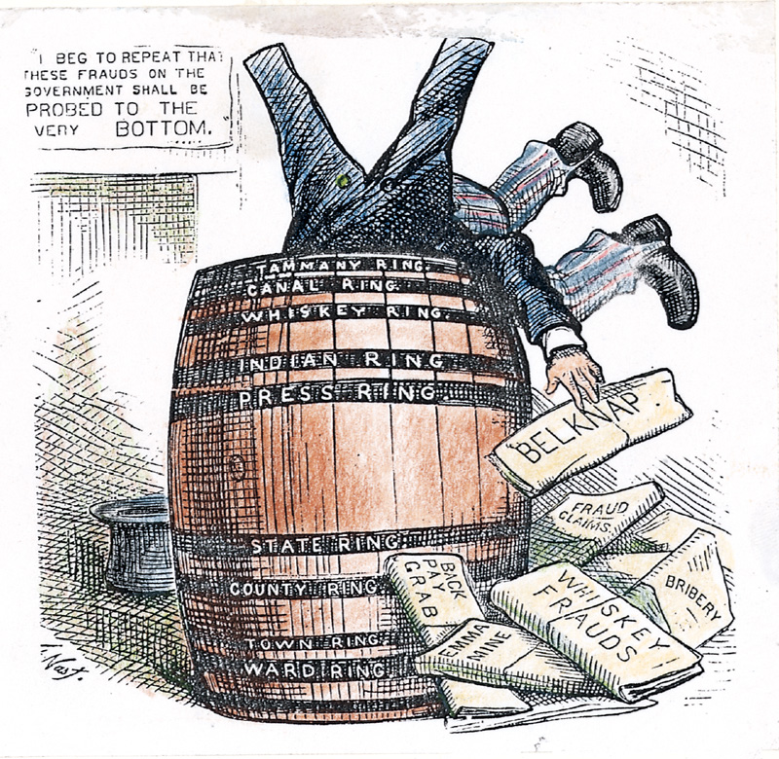
Grant Administration Scandals
Grant presided over an era of unprecedented growth and corruption.
Credit Mobilier Scandal.
Whiskey Ring.
The “Indian Ring.”

Slide 52
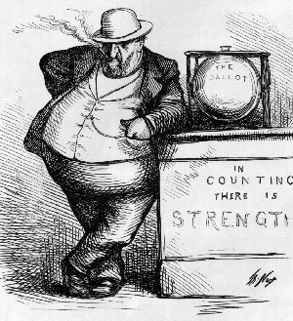
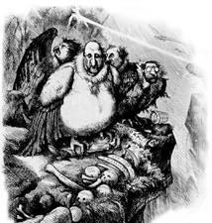
The Tweed Ring in NYC
William Marcy Tweed (notorious head of Tammany Hall’s political machine)
[Thomas Nast → crusading cartoonist/reporter]

Slide 53
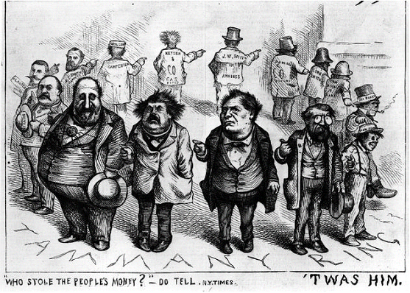
Who Stole the People’s Money?

Slide 54
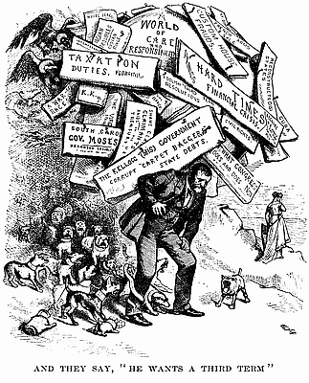
And They Say He Wants a Third Term

Slide 55
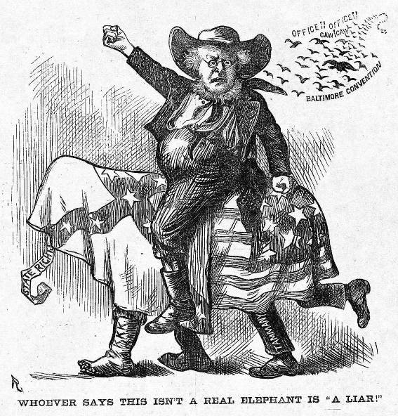
The Election of 1872
Rumors of corruption during Grant’s first term discredit Republicans.
Horace Greeley runs as a Democrat/Liberal Republican candidate.
Greeley attacked as a fool and a crank.
Greeley died on November 29, 1872!

Slide 56
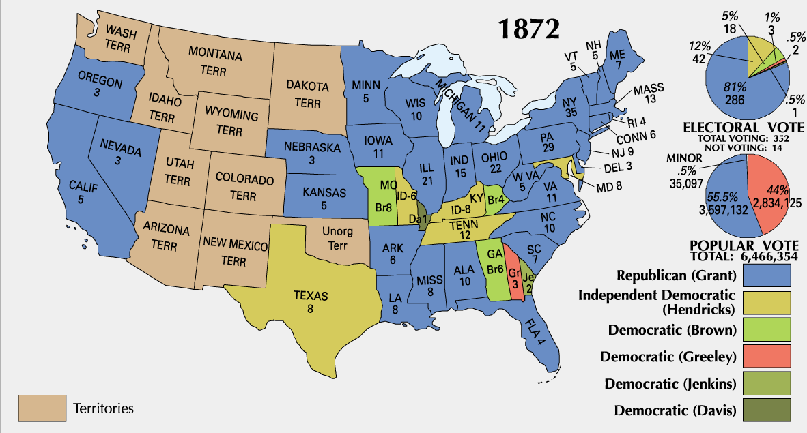
1872 Presidential Election

Slide 57
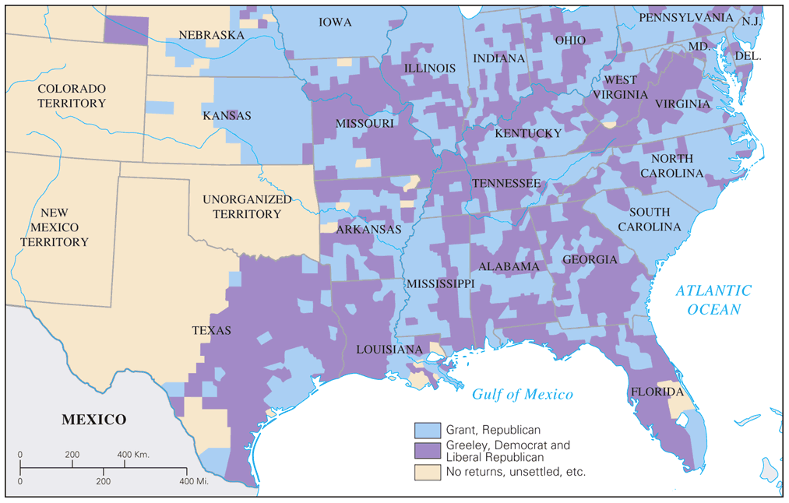
Popular Vote for President: 1872

Slide 58
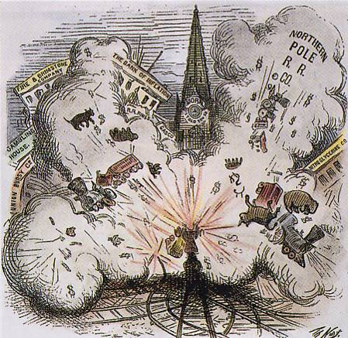
The Panic of 1873
It raises “the money question.”
debtors seek inflationary monetary policy by continuing circulation of greenbacks.
creditors, intellectuals support hard money.
1875 → Specie Redemption Act.
1876 → Greenback Party formed & makes gains in congressional races → The “Crime of ’73’!

Slide 59
Legal Challenges to the 14th & 15th Amendments
The Slaughterhouse Cases (1873)
The court offered a narrow definition of the 14th Amendment.
It distinguished between national and state citizenship.
It gave the states primary authority over citizens’ rights.
Therefore, the courts weakened civil rights enforcement!

Slide 60
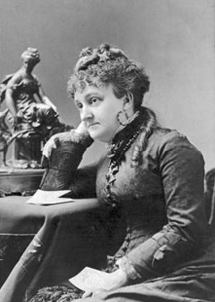
Legal Challenges to the 14th & 15th Amendments
Bradwell vs. Illinois (1873)
Myra Bradwell, a female attorney, had been denied the right to practice law in Illinois.
She argued that in the 14th Amendment, it said that the state had unconstitutionally abridged her “privileges and immunities” as a citizen.
The Supreme Court rejected her claim, alluding to women’s traditional role in the home.
Therefore, she should NOT be practicing law!

Slide 61
Legal Challenges to the 14th & 15th Amendments
U. S. vs. Reese, et. al. (1876)
The Court restricted congressional power to enforce the KKK Act.
The court ruled that the STATE alone could confer voting rights on individuals.
The 15th Amendment did NOT guarantee a citizen’s right to vote, but just listed certain impermissible grounds to deny suffrage.
Therefore, a path lay open for Southern states to disenfranchise blacks for supposedly non-racial reasons [like lack of education, lack of property, etc.]

Slide 62
Legal Challenges to the 14th & 15th Amendments
U. S. vs. Cruickshank (1876)
LA white supremacists accused of attacking a meeting of Blacks & were convicted under the 1870 Enforcement Acts.
The Court held that the 14th Amendment extended the federal power to protect civil rights ONLY in cases involving discrimination by STATES.
Therefore, discrimination by individuals or groups were NOT covered.

Slide 63
Legal Challenges to the 14th & 15th Amendments
Civil Rights Cases (1883)
The Court declared the 1875 Civil Rights Act unconstitutional.
The Court held that the 14th Amendment gave Congress the power to outlaw discriminations by the states, but NOT by private individuals.
Black people must no longer “be the special favorites of the laws.”
Therefore, this marked the end of federal attempts to protect African American rights until well into the 20^{c}!

Slide 64
The
Abandonment
of Reconstruction

Slide 65
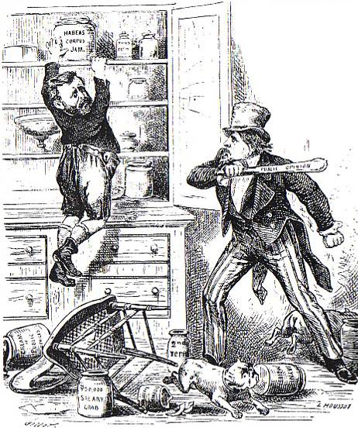
Northern Support Wanes
“Grantism” & corruption.
Panic of 1873 [6-year depression].
Concern over westward expansion and Indian wars.
Key monetary issues:
should the government retire $432m worth of “greenbacks” issued during the Civil War.
should war bonds be paid back in specie or greenbacks.

Slide 66
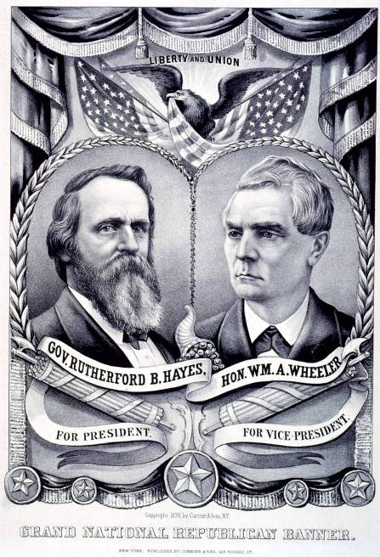
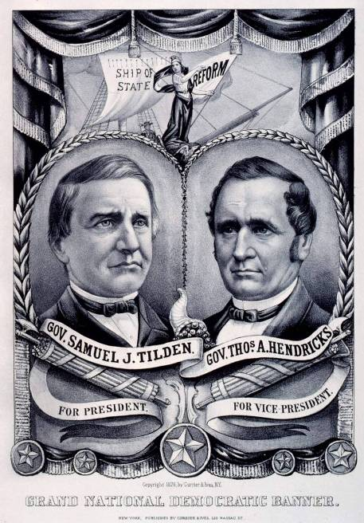
1876 Presidential Tickets

Slide 67
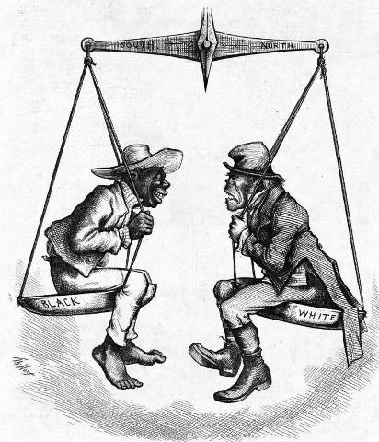
“Regional Balance?”

Slide 68
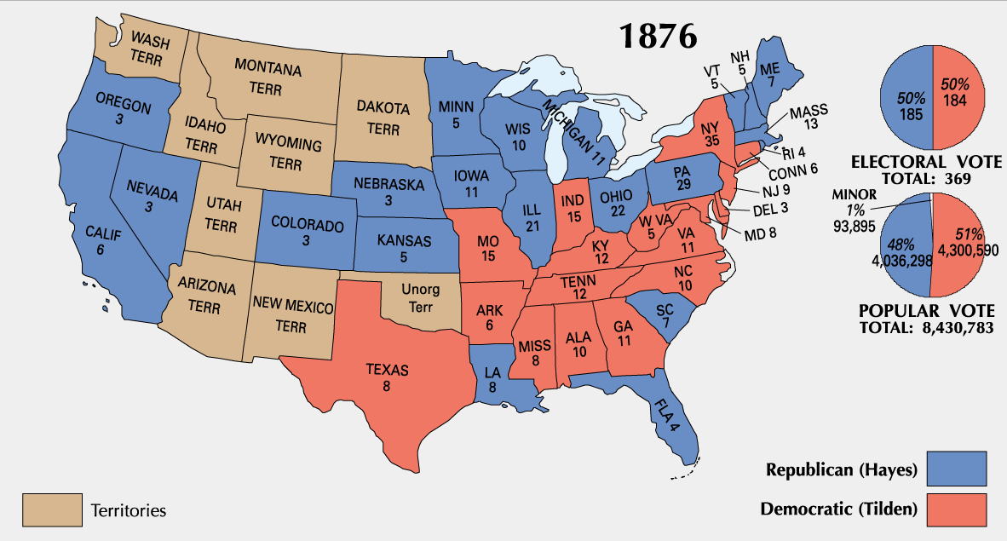
1876 Presidential Election

Slide 69
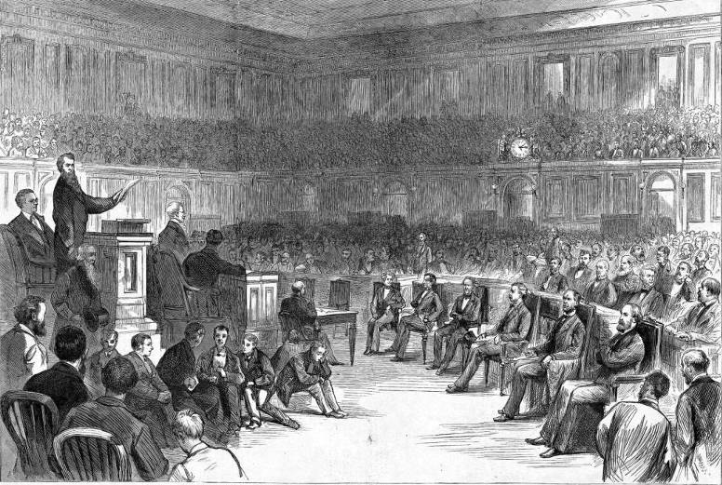
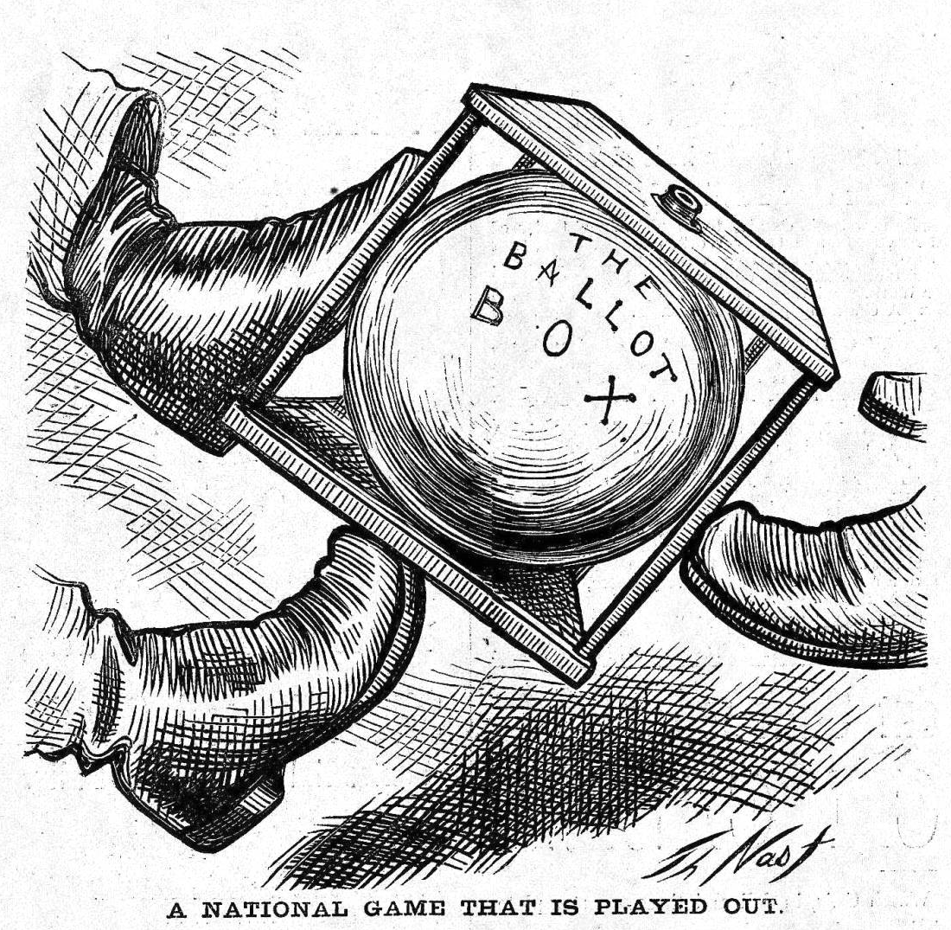
The Political Crisis of 1877
“Corrupt Bargain” Part II?

Slide 70
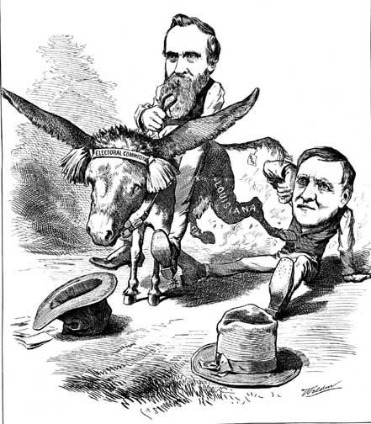
Hayes Prevails

Slide 71
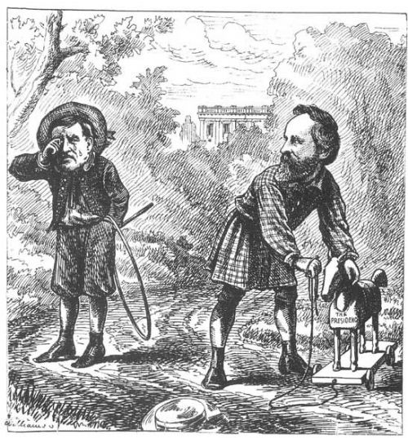
Alas, the Woes of Childhood…
Sammy Tilden—Boo-Hoo! Ruthy Hayes’s got my Presidency, and he won’t give it to me!

Slide 72
A Political Crisis: The “Compromise” of 1877

